Slide 1
Chapter Three
Cascading Style Sheets (CSS)

Slide 2

Contents
What is CSS?
Why use style sheets?
Anatomy of a CSS Rule
CSS Selectors
The Combinators Selector
Linking HTML and CSS
Common CSS Properties
CSS Units

Slide 3
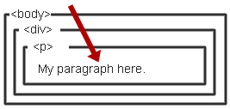
What is CSS?
CSS stands for Cascading Style Sheets
Describes the appearance, layout, and presentation of information on a web page
Describes how information is to be displayed, not what is being displayed
To describe the presentation a document written in a ‘markup language’ like HTML or XML
    Markup encoding: <p>My paragraph here.</p>
    Defines the style of how things in <p> tags appear.
    Font, color, size, margins, etc.
    Cascading
      Rules to determine how to apply markup that contains
      other markup

Slide 4
Why CSS?
Separate Content from Form
  Content is the text and images, marked up to define regions of specific types
  Form defines the “style” for the content
<font size=“14px”>
My First Header
</font>
<font size=“12px” color=“red” face=“Verdana”>
My information 1 goes here.
</font>
<font size=“14px”>
My Second Header
</font>
<font size=“12px” color=“red” face=“Verdana”>
Different information goes here.
</font>
<p class=“header”>My First Header</p>
<p class=“info”>My Information 1 goes here</p>
<p class=“header”>My Second Header</p>
<p class=“info”>Different Information goes here</p>
Content
The Old way
.header { font-size:14px;}
.info { font-family: verdana;
font-color: blue;
font-size: 12px; }
Form/style
Can be embedded in HTML document or placed into separate .css file

Slide 5
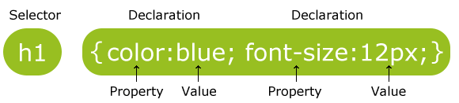
Anatomy of a CSS Rule
A CSS rule-set consists of a selector and a declaration block:
The selector points to the HTML element you want to style.
The declaration block contains one or more declarations separated by semicolons.
Each declaration includes a CSS property name and a value, separated by a colon.
A CSS declaration always ends with a semicolon, and declaration blocks are surrounded by curly braces.

Slide 6
… e.g.
In the following example all <p> elements will be center-aligned, with a red text color:
p {
color: red;
text-align: center;
}
CSS Comments - starts with /* and ends with */.

Slide 7
CSS Selectors
CSS selectors are used to "find" (or select) HTML elements based on their element name, id, class, attribute, and more
selects elements based on the element name
p {
text-align: center;
color: red;
}
The element Selector
You can select all <p> elements on a page like this (in this case, all <p> elements will be center-aligned, with a red text color):

Slide 8
CSS Selectors
uses the id attribute of an HTML element to select a specific element
The id of an element should be unique within a page
To select an element with a specific id, write a hash (#) character, followed by the id of the element.
The id Selector
#para1 {
text-align: center;
color: red;
}
<p id=“para1”> Hello world </p>
The style rule above will be applied to the HTML element with id="para1":
Note: An id name cannot start with a number!

Slide 9
CSS Selectors
It selects the elements with a specific class attribute.
To select elements with a specific class, write a period (.) character, followed by the name of the class.
HTML elements can also refer to more than one class.
.center {
text-align: center;
color: red;
}
The Class Selector
<p class=“center”> Hello world </p>
In the above example, all HTML elements with class="center" will be red and center-aligned.
A class name cannot start with a number!

Slide 10
CSS Selectors
If you have elements with the same style definitions, like this:
h1 {
text-align: center;
color: red;
}
h2 {
text-align: center;
color: red;
}
p {
text-align: center;
color: red;
}
h1, h2, p {
text-align: center;
color: red;
}
The Grouping Selector

Slide 11
The Combinators Selector
A combinator is something that explains the relationship between the selectors
There are four different combinators in CSS:
  descendant selector (space)
  child selector (>)
  adjacent sibling selector (+)
  general sibling selector (~)

Slide 12
…cont’d
Selector | Example | Example description
element element | div p | Selects all <p> elements inside <div> elements
element>element | div > p | Selects all <p> elements where the parent is a <div> element
element+element | div + p | Selects the first <p> element that are placed immediately after <div> elements
element1~element2 | p ~ ul | Selects every <ul> element that are preceded by a <p> element

Slide 13
…examples
  descendant selector (space)
  child selector (>)
div p {
background-color: yellow;
}
div > p {
background-color: yellow;
}
<div>
<h2>My name is Donald</h2>
<p>I live in Duckburg.</p>
</div>
<div>
<h2>My name is Donald</h2>
<p>I live in Duckburg.</p>
</div>
<div>
<span>
<p>I will not be styled.</p>
</span>
</div>

Slide 14
…examples
  Adjacent sibling selector (+)
  General sibling selector (~)
div + p {
background-color: yellow;
}
div ~ p {
background-color: yellow;
}
<div>
<h2>My name is Donald</h2>
<p>I live in Duckburg.</p>
</div>
<p>My best friend is Mickey.</p>
<p>I will not be styled.</p>
<div>
<h2>My name is Donald</h2>
<p>I live in Duckburg.</p>
</div>
<p>My best friend is Mickey.</p>
<p>I will not be styled.</p>

Slide 15
Linking HTML and CSS
There are three ways of inserting a style sheet:
Inline style sheet
used to apply a unique style for a single element, by adding the style attribute to the relevant element.
Internal style sheet
Defined within the <style> element, inside the <head> section of an HTML page
External style sheet
a separate file (.css) where you can declare all the styles that you want to use on your website

Slide 16
… example
Inline style sheet
<h1 style="color:blue;margin-left:30px;">This is a heading.</h1>
Internal style sheet
<head>
<style>
h1{
color: orange;
margin-left: 30px;
}
</style>
</head>
External style sheet
<head>
<link rel="stylesheet" type="text/css" href="mystyle.css">
</head>
h1{
color: orange;
margin-left: 30px;
}

Slide 17
Cascading Order
What style will be used when there is more than one style specified for an HTML element?
Order:
    Inline style (inside an HTML element)
    External and internal style sheets (in the head section)
    Browser default
So, an inline style (inside a specific HTML element) has the highest priority, which means that it will override a style defined inside the <head> tag, or in an external style sheet, or a browser default value.

Slide 18
Common CSS Properties
Text
Background
Positioning
color
background-color
position
:color|initial|inherit
color|transparent|initial|inherit
static|absolute|fixed|relative|init..
font-size
background-size
float
:length|initial|inherit
auto|length|cover|contain|
initial|inherit;
none|left|right|init..
Text-align
background-image
clear
:left|right|center|justify|
initial|inherit
url|none|initial|inherit;
none|left|right|both|init…
text-decoration
background-repeat
overflow
:Line|color|style|initial|
inherit
repeat|repeat-x|repeat-y|
no-repeat|initial|inherit;
visible|hidden|scroll|auto…
Offset Properties
top|left|bottom|right :length

Slide 19
CSS colors
CSS uses color values to specify a color.
Typically, these are used to set a color either for the foreground of an element (i.e., its text) or else for the background of the element.
They can also be used to affect the color of borders and other decorative effects.
Colors can be specified using predefined color names, or RGB, HEX, HSL, RGBA, HSLA values. (A- stands for alpha channel – to specify opacity)
The first and easiest way to specify a color is using one of the 140 predefined color keywords specified in CSS. [CSS Colors (w3schools.com)]

Slide 20
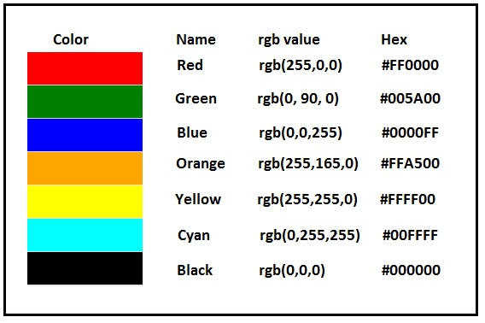
With CSS, a color is most often specified by:
<h1 style="color:red;">Hello world</h1>
Hello world
<h2 style="background-color:rgb(0, 0, 255);">Hello world</h1>
Hello world
<h1 style="border:2px solid #00ff00;">Hello World</h1>
Hello world

Slide 21

CSS backgrounds
The CSS background properties are used to add background effects for elements.
css properties used for background effects:
  background-color - specifies the background color of an element
  background-image - specifies an image to use as the background of an element
  - By default, the image is repeated so it covers the entire element
  background-repeat – repeats an image both horizontally and vertically
  - (Some images should be repeated only horizontally or vertically)
  background-attachment – specifies whether the background image should scroll or be fixed (will not scroll with the rest of the page)
  background-position - to specify the position of the background image
  e.g. background-position: right top;
  background (shorthand property)
  background: #ffffff url(“xyz.png") no-repeat right top;
<h1 style="background-color:red">Hello world</h1>
Hello world
P{ background-image: url(“dog.jpeg"); }

Slide 22
CSS Borders
The CSS border properties allow you to specify the style, width, and color of an element's border.
Border Style
The border-style property specifies what kind of border to display.
The following values are allowed:
  dotted - Defines a dotted border
  dashed - Defines a dashed border
  solid - Defines a solid border
  double - Defines a double border
The border-style property can have from one to four values (for the top border, right border, bottom border, and the left border).
Border Color
Border - Shorthand Property
p {
border-style: solid;
}
<p>Hello world.</p>
Hello world
Hello world
Hello world
p {
border: 2px solid red;
border-radius: 5px;
}
border-radius

Slide 23
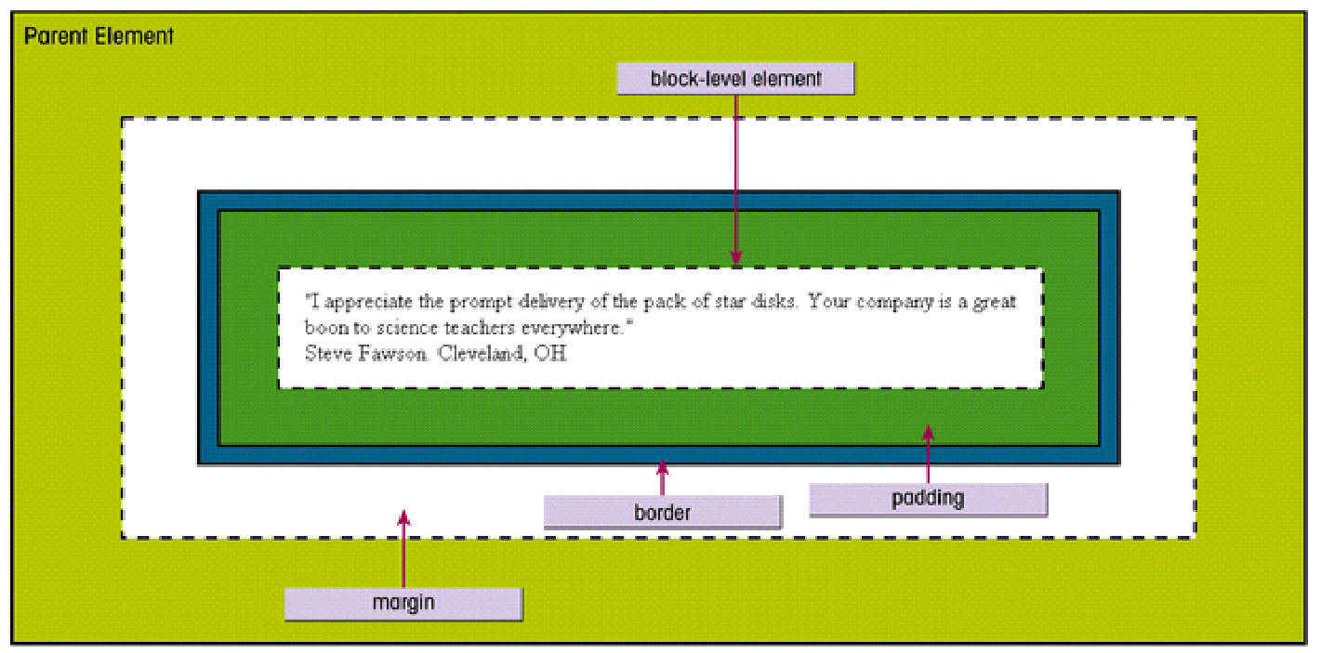
CSS Box Model
CSS box model is the foundation of design and layout of the web.
It is simply box or a rectangular box.
The CSS box model is essentially a box that wraps around every HTML element. It consists of: margins, borders, padding, and the actual content.
The image below illustrates the box model:

Slide 24
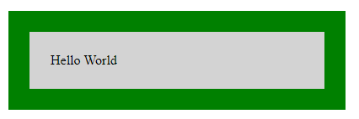
…cont’d
Explanation of the different parts:
Content - The content of the box, where text and images appear
Padding - Clears an area around the content. The padding is transparent
Border - A border that goes around the padding and content
Margin - Clears an area outside the border. The margin is transparent
The box model allows us to add a border around elements, and to define space between elements.
The box-sizing property allows us to include the padding and border in an element's total width and height.
box-sizing: border-box;
div {
width: 300px;
border: 25px solid green;
padding: 25px;
margin: 25px;
}

Slide 25
CSS Margins
The CSS margin properties are used to create space around elements, outside of any defined borders.
Margin - Individual Sides
CSS has properties for specifying the margin for each side of an element:
  margin-top
  margin-right
  margin-bottom
  margin-left
All the margin properties can have the following values:
  auto - the browser calculates the margin horizontally to center the element within its container
  length - specifies a margin in px, pt, cm, etc.
  % - specifies a margin in % of the width of the containing element
  inherit - specifies that the margin should be inherited from the parent element
    Tip: Negative values are allowed.
Margin - Shorthand Property - it is possible to specify all the margin properties in one property. 🡪 margin: Top Right Bottom Left; 🡪 margin: 25px 50px 75px 100px;
  Can also be given as two values 🡪 margin: Top|Bottom Right|Left; 🡪 margin: 20px 10px;
p {
margin-top: 100px;
margin-bottom: 100px;
margin-right: 150px;
margin-left: 80px;
}

Slide 26
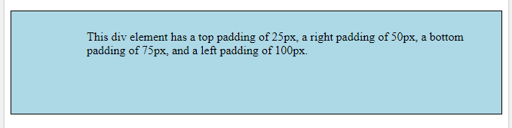
CSS Padding
The CSS padding properties are used to generate space around an element's content, inside of any defined borders.
CSS has properties for specifying the padding for each side of an element:
  padding-top
  padding-right
  padding-bottom
  padding-left
Padding - Shorthand Property
To shorten the code, it is possible to specify all the padding properties in one property.
If the padding property has four values: padding: 25px 50px 75px 100px; 🡪 Top Right Bottom Left

Slide 27
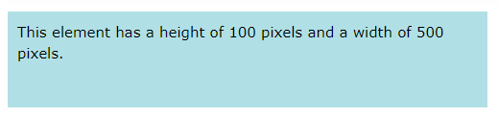
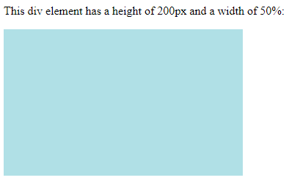
Setting height and width
The height and width properties are used to set the height and width of an element.
Note: The height and width properties do not include padding, borders, or margins; they set the height/width of the area inside the padding, border, and margin of the element!
div {
width: 500px;
height: 100px;
background-color: powderblue;
}
div {
height: 200px;
width: 50%;
background-color: powderblue;
}

Slide 28
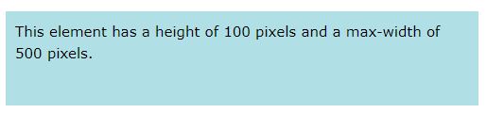
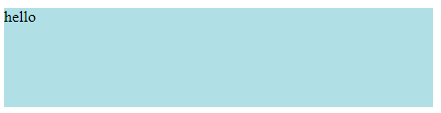
Minimum and Maximum Width and Heights
The following properties define CSS minimum and maximum width and heights.
min-width: sets the minimum width of an element
max-width: sets the maximum width of an element
min-height: sets the minimum height of an element
max-height: sets the maximum height of an element
Note: The value of the max-width property overrides width. Resize the window to see the effect.
div {
max-width: 500px;
height: 100px;
background-color: powderblue;
}
div {
min-width: 50px;
height: 100px;
background-color: powderblue;
}

Slide 29
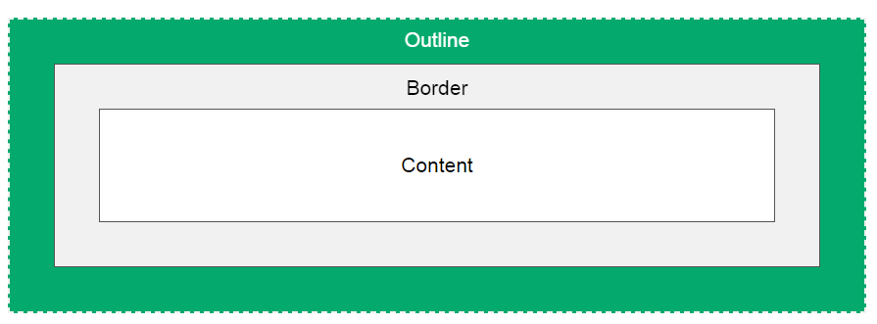
CSS Outline
An outline is a line that is drawn around elements, OUTSIDE the borders, to make the element "stand out".
Outline differs from borders! Unlike border, the outline is drawn outside the element's border, and may overlap other content.
Also, the outline is NOT a part of the element's dimensions; the element's total width and height is not affected by the width of the outline.
CSS has the following outline properties:
outline-style
outline-color
outline-width
outline-offset –space b/n border and outline
outline – shorthand form

Slide 30
CSS Units
CSS has several different units for expressing a length.
There are two types of length units: absolute and relative.
The absolute length units are fixed and a length expressed in any of these will appear as exactly that size.
Absolute length units are not recommended for use on screen, because screen sizes vary so much. However, they can be used if the output medium is known, such as for print layout.
absolute
Unit | Cm | mm | in | px | pt | pc
Description | centimeters 1cm =37.7px | Millimeters 1mm=3.77px | inches (1in = 96px = 2.54cm) | pixels (1px = 1/96th of 1in) | points (1pt = 1/72 of 1in) | picas (1pc = 12 pt)

Slide 31
CSS Units
relative
Relative length units specify a length relative to another length property.
Relative length units scales better between different rendering mediums.
Unit | Description
em | Relative to the font-size of the element (2em means 2 times the size of the current font)
rem | Relative to font-size of the root element
vw | Relative to 1% of the width of the viewport*
vh | Relative to 1% of the height of the viewport*
% | Relative to the parent element

Slide 32
CSS Text
CSS has a lot of properties for formatting text.
CSS text properties:
  color: specifies the color of text.
  text-align: A text can be left or right aligned, centered, or justified.
  text-decoration: underline, overline, line-through, none
  text-transform: uppercase, lowercase, capitalize
  letter-spacing: property is used to specify the space between the characters in a text.
  line-height: property is used to specify the space between lines:
  word-spacing: property is used to specify the space between the words in a text.
  text-indent: property is used to specify the indentation of the first line of a text:
  text-shadow: property adds shadow to text.
h1{
text-shadow: 2px 2px 2px red;
}

Slide 33
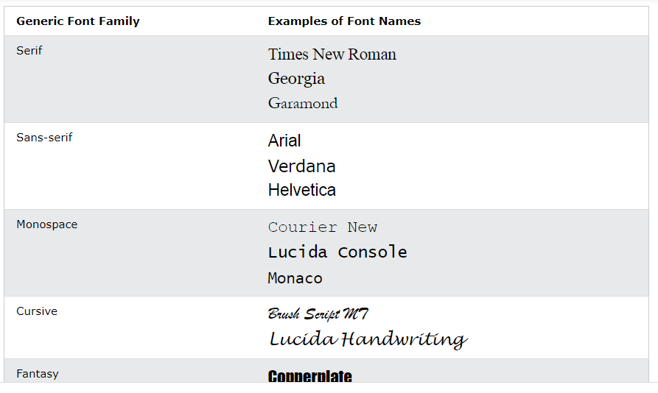
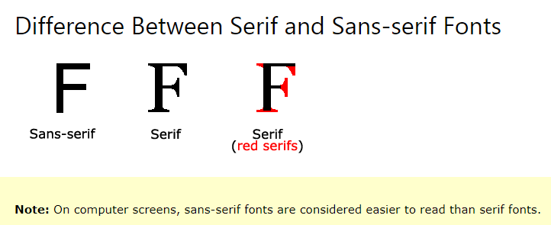
CSS Fonts
Choosing the right font for your website is important!
In CSS there are five generic font families:
Applying a list of fonts - By defining multiple values for font-family, the browser will look for available font family by the given order, if it’s not available either, it will use the browser’s default sans-serif font.
body{
font-family: Arial, Verdana, sans-serif;
}

Slide 34
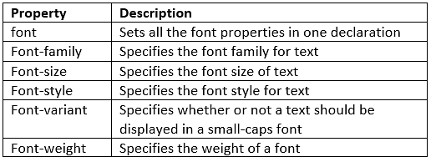
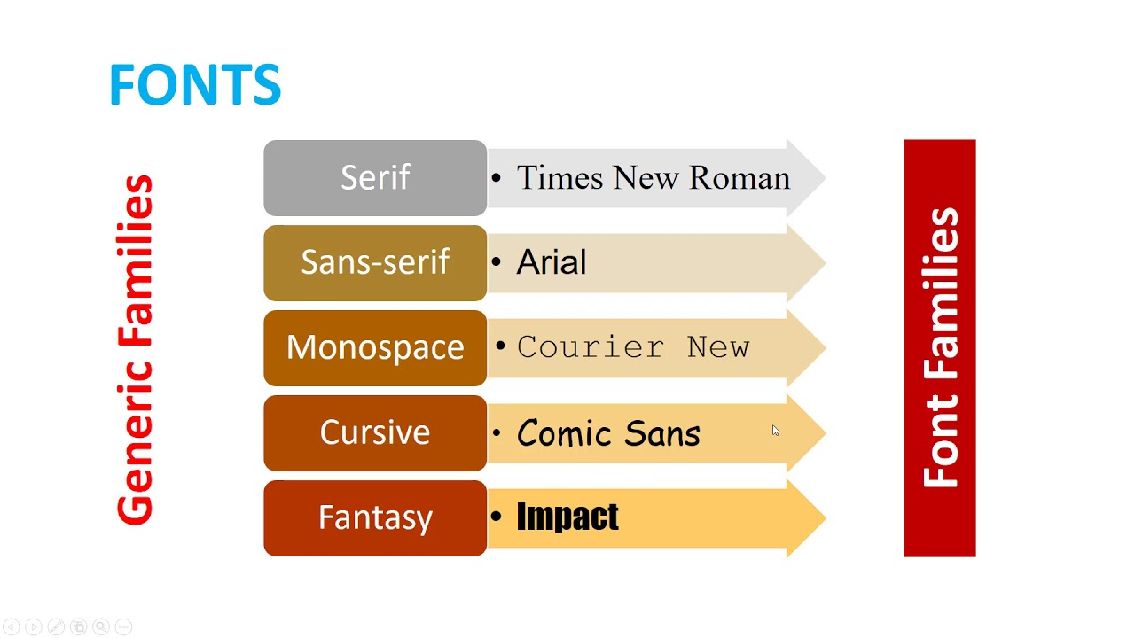
…cont’d
The CSS Font Property
.p1 {
font-family: "Times New Roman", Times, serif;
font-style: italic;
font-weight: bold;
font-variant: normal;
font-size: 40px;
}
The font property is a shorthand property for:
font-style
font-variant
font-weight
font-size/line-height
font-family
p {
font: italic small-caps bold 12px/30px Georgia, serif;
}

Slide 35
CSS Pseudo-classes
A pseudo-class is used to define a special state of an element.
  For example, it can be used to:
    Style an element when a user mouses over it
    Style visited and unvisited links differently
    Style an element when it gets focus
The syntax of pseudo-classes:
selector:pseudo-class
{
property:value;
}

Slide 36
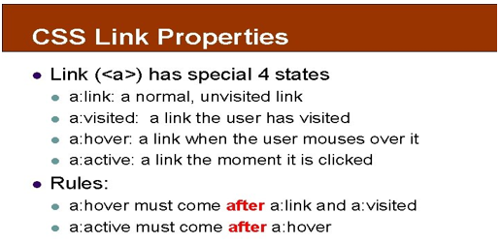
Anchor Pseudo-classes
With CSS, links can be styled in many different ways.
Links can be styled with any CSS property (e.g. color, font-family, background, etc.).
Text Decoration
The text-decoration property is mostly used to remove underlines from links:
/* unvisited link */
a:link {
color: red;
}
/* visited link */
a:visited {
color: green;
}
/* mouse over link */
a:hover {
color: hotpink;
}
/* selected link */
a:active {
color: blue;
a:hover {
text-decoration: underline;
}
This is a link

Slide 37
…cont’d
Pseudo-classes and CSS Classes
Pseudo-classes can be combined with CSS classes:
When you hover over the link in the example, it will change color:
Hover on <div>
An example of using the :hover pseudo-class on a <div> element:
CSS - The :first-child Pseudo-class
The :first-child pseudo-class matches a specified element that is the first child of another element.
a.highlight:hover {
color: #ff0000;
}
div:hover {
background-color: blue;
}
p:first-child {
color: blue;
}
This is some text.
This is some text.
<p>This is some text.</p>
<p>This is some text.</p>

Slide 38
…cont’d
CSS Pseudo Elements - used to style specified parts of an element.
selector::pseudo-element {
property: value;
}
p::after {
content: " - Remember this";
}
Selector | Example | Example description
::after | p::after | Insert content after every <p> element
::before | p::before | Insert content before every <p> element
::first-letter | p::first-letter | Selects the first letter of every <p> element
::first-line | p::first-line | Selects the first line of every <p> element
::selection | p::selection | Selects the portion of an element that is selected by a user
<p>My name is Rodas</p>
<p>I live in Arba Minch</p>
My name is Rodas - Remember this
I live in Arba Minch - Remember this

Slide 39
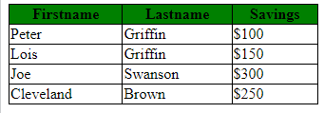
CSS tables
To specify table borders in CSS, use the border property.
The example below specifies a solid border for <table>, <th>, and <td> elements:
Collapse Table Borders
The border-collapse property sets whether the table borders should be collapsed into a single border:
table, td, th {
border: 1px solid black;
}
table {
border-collapse: collapse;
width: 50%;
}
th
{
background-color:green;
}
tr:nth-child(even) {
background-color: yellow;
}
tr:first-child {
background-color: red;
}

Slide 40
CSS Layout - The display Property
The display property is the most important CSS property for controlling layout.
The display property specifies how an element is displayed.
Every HTML element has a default display value depending on what type of element it is. The default display value for most elements is block or inline.
Block-level Elements
A block-level element always starts on a new line and takes up the full width available (stretches out to the left and right as far as it can).
Examples of block-level elements:
<div>, <h1> - <h6>, <p>, <form>, <header>, <footer>, <section>
Inline Elements
An inline element does not start on a new line and only takes up as much width as necessary.
Examples of inline elements:
<span>, <a>, <img>

Slide 41


…cont’d
every element has a default display value. However, you can override this.
Changing an inline element to a block element, or vice versa, can be useful for making the page look a specific way, and still follow the web standards.
A common example is making inline <li> elements for horizontal menus:
Note: Setting the display property of an element only changes how the element is displayed, NOT what kind of element it is. So, an inline element with display: block; is not allowed to have other block elements inside it.
li {
display: inline;
}
<ul>
<li><a href="/html/default.asp" target="_blank">HTML</a></li>
<li><a href="/css/default.asp" target="_blank">CSS</a></li>
<li><a href="/js/default.asp" target="_blank">JavaScript</a></li>
</ul>
<a href="/html/default.asp" target="_blank">HTML</a>
<a href="/css/default.asp" target="_blank">CSS</a>
<a href="/js/default.asp" target="_blank">JavaScript</a>
a {
display: block;
}

Slide 42
CSS Layout - The position Property
The position property specifies the type of positioning method used for an element.
There are five different position values:
Elements are then positioned using the top, bottom, left, and right properties.
However, these properties will not work unless the position property is set first. They also work differently depending on the position value.
position: static
HTML elements are positioned static by default.
Static positioned elements are not affected by the top, bottom, left, and right properties.
An element with position: static; is not positioned in any special way; it is always positioned according to the normal flow of the page:
static | relative | fixed | absolute | sticky

Slide 43
…cont’d
position: relative
An element with position: relative; is positioned relative to its normal position.
Setting the top, right, bottom, and left properties of a relatively-positioned element will cause it to be adjusted away from its normal position.
Other content will not be adjusted to fit into any gap left by the element.
div.relative {
position: relative;
left: 30px;
border: 3px solid #73AD21;
}
<div class="relative">
This div element has position: relative;
</div>

Slide 44
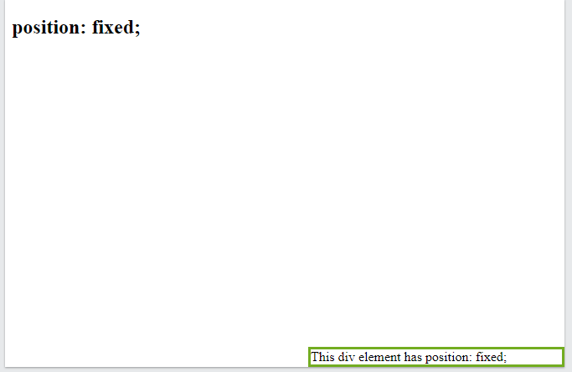
…cont’d
position: fixed
An element with position: fixed; is positioned relative to the viewport, which means it always stays in the same place even if the page is scrolled. The top, right, bottom, and left properties are used to position the element.
A fixed element does not leave a gap in the page where it would normally have been located.
div.fixed {
position: fixed;
bottom: 0;
right: 0;
width: 300px;
border: 3px solid #73AD21;
}
<h2>position: fixed;</h2>
<div class="fixed">
This div element has position: fixed;
</div>

Slide 45
…cont’d
position: absolute
An element with position: absolute; is positioned relative to the nearest positioned ancestor (instead of positioned relative to the viewport, like fixed).
However; if an absolute positioned element has no positioned ancestors, it uses the document body, and moves along with page scrolling.
Note: Absolute positioned elements are removed from the normal flow, and can overlap elements.

Slide 46
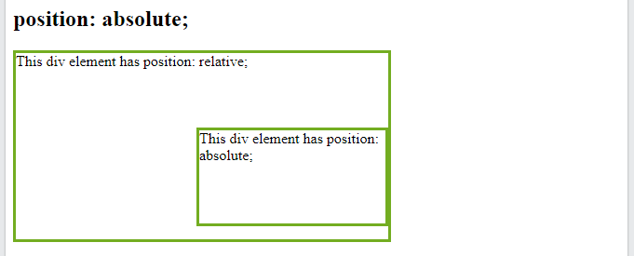
…cont’d
position: absolute
<h2>position: absolute;</h2>
<div class="relative">This div element has position: relative;
<div class="absolute">This div element has position: absolute;</div>
</div>
div.relative {
position: relative;
width: 400px;
height: 200px;
border: 3px solid #73AD21;
}
div.absolute {
position: absolute;
top: 80px;
right: 0;
width: 200px;
height: 100px;
border: 3px solid #73AD21;
}

Slide 47
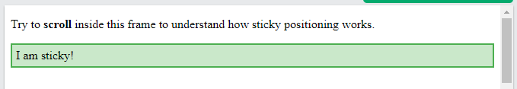
…cont’d
position: sticky
An element with position: sticky; is positioned based on the user's scroll position.
A sticky element toggles between relative and fixed, depending on the scroll position.
It is positioned relative until a given offset position is met in the viewport - then it "sticks" in place (like position:fixed).
You must also specify at least one of top, right, bottom or left for sticky positioning to work.
div.sticky {
position: -webkit-sticky;
position: sticky;
top: 0;
padding: 5px;
background-color: #cae8ca;
border: 2px solid #4CAF50;
}
<p>Try to <b>scroll</b> inside this frame to understand how sticky positioning works.</p>
<div class="sticky">I am sticky!</div>

Slide 48
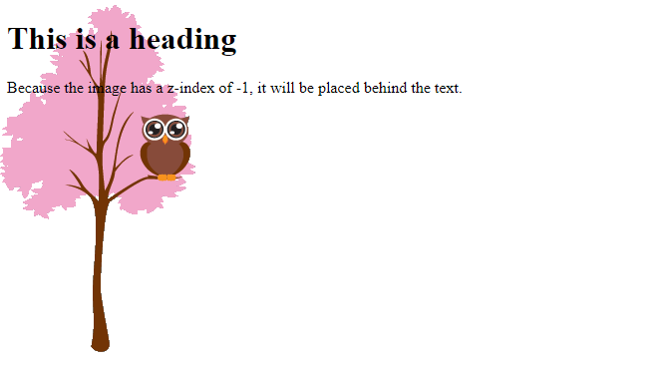
CSS Layout - The z-index
When elements are positioned, they can overlap other elements.
The z-index property specifies the stack order of an element (which element should be placed in front of, or behind, the others).
An element can have a positive or negative stack order:
Note: z-index only works on positioned elements (position: absolute, position: relative, position: fixed, or position: sticky) and flex items (elements that are direct children of display: flex elements).
img {
position: absolute;
left: 0px;
top: 0px;
z-index: -1;
}
<h1>This is a heading</h1>
<img src="img_tree.png">
<p>Because the image has a z-index of -1, it will be placed behind the text.</p>

Slide 49
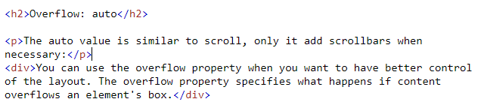
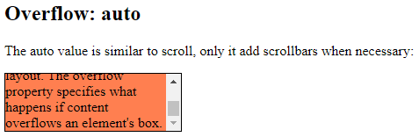
CSS Overflow
The overflow property specifies whether to clip the content or to add scrollbars when the content of an element is too big to fit in the specified area.
The overflow property has the following values: visible, hidden, scroll and auto.
scroll - The overflow is clipped, and a scrollbar is added to see the rest of the content
Note: The overflow property only works for block elements with a specified height.
div {
background-color: coral;
width: 200px;
height: 65px;
border: 1px solid black;
overflow: auto;
}

Slide 50
CSS Layout - float and clear
The CSS float property specifies how an element should float.
The CSS clear property specifies what elements can float beside the cleared element and on which side.
The float Property
The float property is used for positioning and formatting content e.g. let an image float left to the text in a container.
The float property can have one of the following values:
left - The element floats to the left of its container
right - The element floats to the right of its container
none - The element does not float (will be displayed just where it occurs in the text). This is default
inherit - The element inherits the float value of its parent
In its simplest use, the float property can be used to wrap text around images.

Slide 51
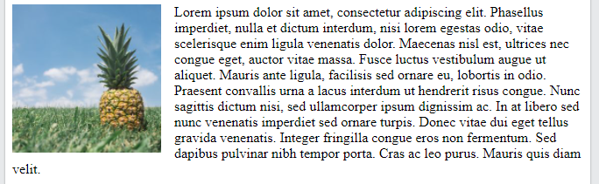
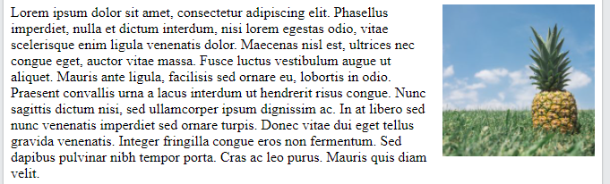
…cont’d
img {
float: left;
}
img {
float: right;
}

Slide 52

The clear Property
When we use the float property, and we want the next element below (not on right or left), we will have to use the clear property.
The clear property specifies what should happen with the element that is next to a floating element.
The clear property can have one of the following values:
none - The element is not pushed below left or right floated elements. This is default
left - The element is pushed below left floated elements
right - The element is pushed below right floated elements
both - The element is pushed below both left and right floated elements
inherit - The element inherits the clear value from its parent
When clearing floats, you should match the clear to the float: If an element is floated to the left, then you should clear to the left. Your floated element will continue to float, but the cleared element will appear below it on the web page.
div {
float: left;
padding: 15px;
}
.div1 {
background: red;
}
.div2 {
background: yellow;
}
.div3 {
background: green;
}
<div class="div1">Div 1</div>
<div class="div2">Div 2</div>
<div class="div3">Div 3</div>

Slide 53
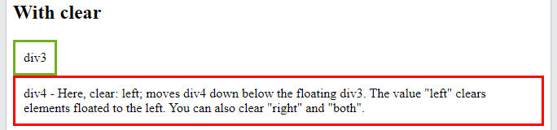
The clear Property
.div3 {
float: left;
padding: 10px;
border: 3px solid #73AD21;
}
.div4 {
padding: 10px;
border: 3px solid red;
clear: left;
}
<h2>With clear</h2>
<div class="div3">div3</div>
<div class="div4">div4 - Here, clear: left; moves div4 down below the floating div3. The value "left" clears elements floated to the left. You can also clear "right" and "both".</div>

Slide 54

CSS Layout - display: inline-block
display: inline-block allows to set a width and height on the element.
with display: inline-block, the top and bottom margins/paddings are respected, but with display: inline they are not.
Compared to display: block, the major difference is that display: inline-block does not add a line-break after the element, so the element can sit next to other elements.
.nav {
background-color: yellow;
list-style-type: none;
text-align: center;
margin: 0;
padding: 0;
}
.nav li {
display: inline-block;
font-size: 20px;
padding: 20px;
}
<ul class="nav">
<li><a href="#home">Home</a></li>
<li><a href="#about">About Us</a></li>
<li><a href="#clients">Our Clients</a></li>
<li><a href="#contact">Contact Us</a></li>
</ul>

Slide 55
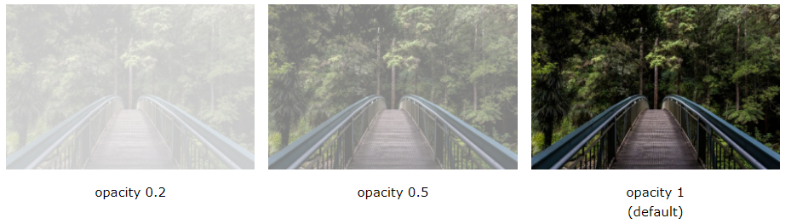

CSS Opacity / Transparency
The opacity property specifies the opacity/transparency of an element.
Transparent Image
The opacity property can take a value from 0.0 - 1.0. The lower value, the more transparent:
img {
opacity: 0.5;
filter: alpha(opacity=50); /* For IE8 and earlier */
}
<img src="img_forest.jpg" alt="Forest" width="170" height="100">

Slide 56
CSS Specificity
What is Specificity?
If there are two or more CSS rules that point to the same element, the selector with the highest specificity value will "win", and its style declaration will be applied to that HTML element.
<html>
<head>
<style>
p {
color: red;
}
</style>
</head>
<body>
<p>Hello!</p>
</body>
</html>
<html>
<head>
<style>
.test {color: green;}
p {color: red;}
</style>
</head>
<body>
<p class="test">Hello!</p>
</body>
</html>
<html>
<head>
<style>
#demo {color: blue;}
.test {color: green;}
p {color: red;}
</style>
</head>
<body>
<p id="demo" class="test">Hello!</p>
</body>
</html>
<html>
<head>
<style>
#demo {color: blue;}
.test {color: green;}
p {color: red;}
</style>
</head>
<body>
<p id="demo" class="test" style="color: orange;">Hello!</p>
</body>
</html>

Slide 57
…cont’d
Specificity Hierarchy
Every CSS selector has its place in the specificity hierarchy.
There are four categories which define the specificity level of a selector:
  Inline styles - Example: <h1 style="color: orange;">
  IDs - Example: #navbar
  Classes, pseudo-classes, attribute selectors - Example: .test, :hover, [href]
  Elements and pseudo-elements - Example: h1, :before
Equal specificity: the latest rule wins - If the same rule is written twice into the external style sheet, then the latest rule wins:
<style>
  h1 { color: yellow;}
  h1 { color: red;}
</style>
<h1>This is heading 1</h1>

Slide 58
The End!

